Slide 1
2023-2024 Welcome
Year 11 GCSE Information Evening

Slide 2
Agenda
RB
Introduction – Matt Pryse and Rachael Burden
Achievement, Progress and Next Steps – Rachael Burden - Assistant Principal
Mathematics - Leon Morris, Head of Maths
Science – Maureen Walker, Deputy Head of Science
English - Charlene Williams, Deputy Head of E English
Pastoral and Revision - Matt Pryse, Head of Year Vince Shell, KS4 Pastoral Support
Question and Answers

Slide 3
Vision for Wye
RB
Continue to be a smaller than average community school that has strong relationships and happy students
A well-behaved school with traditional good manners and respect for people of all backgrounds
Outward facing, using the best of United Learning's experience in private and state schools across England
Students making excellent academic progress
That Year 11 leave us in nine months' time (and that time will fly) qualified and ready for their next step.
That as many Year 11s as possible have high enough grades to be suitable for further academic study in our 6th Form, or the provider of their choice.

Slide 4
Priorities for Year 11
RB
To accept only the very best of themselves
No limits, no barriers to success or learning
To be fully aware of the challenges this year,
but not too stressed by them
To be fully prepared for the next steps,
understanding that they are laying the
foundation for lifelong success

Slide 5
RB
Children only get one chance - but are not alone, we will support you all the way to success
'we' = parents and school

Slide 6
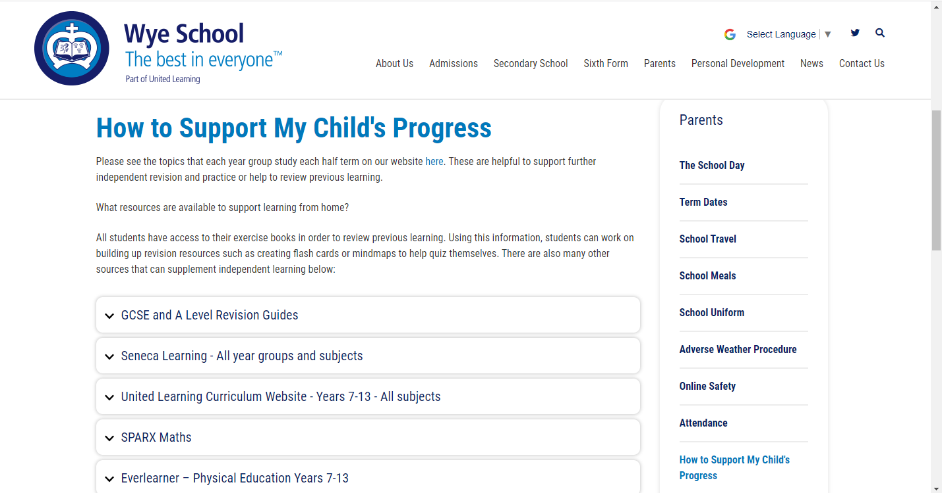
Support
RB
Parental support is 8 times more important
in determining a child’s academic success than social class.
The Campaign for Learning found that parental involvement in a child’s education can mean the difference between two grades at GCSE level.

Slide 7
Your Number is almost up…!
RBu
2235 – Number of days in school from foundation stage up until year 11
2090 Days completed
180 Days left (8%!)
145 Hours of English lessons for 2 GCSEs
115 Hours of Mathematics
55 Hours of Science lessons per science
70 Hours of Options subjects

Slide 8
For the current Year 11
RBu

Slide 9
Support - what can you do?
RBu
Provide a quiet space for students to work.
Show interest each day in what they are doing.
Try to resist giving students the impression that a subject doesn't matter eg 'I was never any good at science'.
Correct language – if your son daughter says they cannot do it, qualify this – they cannot do it yet!
Be familiar with deadlines – put these on the family calendar / outlook etc.
Look at books, ask questions, help with a revision timetable.
Remind your child that to succeed, you must work hard!
Regularly check they have the correct equipment
Make sure they eat a healthy breakfast before school
Ensure that they attend school.

Slide 10
Support - where else can you turn?
RBu
Listen and if there is a real concern, please contact us. If a student has an issue with a subject, we can help to provide support and encouragement. Use Form tutors as first port of call.
Ask about period 7 sessions and tutor times – students will be doing additional work towards core and other subjects during these times.

Slide 11
Attendance is the most fundamental requirement
RBu
* and a square without good GCSEs
*

Slide 12
Our Success
RBu
In 2018, our Progress 8 Score at Wye School was +0.3.
In 2019, our Progress 8 Score was +0.33.
This means that students are making a third of a grade more progress than at other schools.
This continues to make Wye School the best non selective schools in the area.

Slide 13
Summary – the secrets to success
RBu

Slide 14
How well is my child doing?
RB
From the mock exams in November/December, you will receive the following:
Current Grades – This indicates the level they are currently working at.
Target Grades – This is an aspirational grade based on their Key Stage 2 SATS scores. If they achieve their target grade, they are making excellent progress.
Predicted Grade – This is the grade we think they will achieve at the end of the course.
Learning Indicator – This is an effort grade. It can be either Poor, Requires Improvement, Good or Excellent.

Slide 15
Post-16 Options
MP
Students at Wye will soon be completing their Post-16 Options.
We will be supporting them with their application through Kent Choices.
We strongly encourage you to visit open days over the coming 2 months.

Slide 16
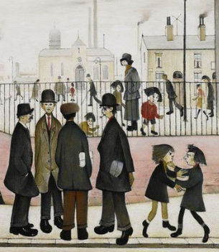
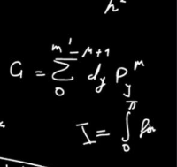
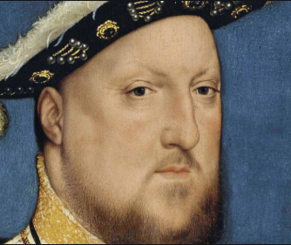
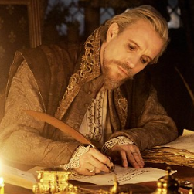
MP
A flexible, academic A level offer...
Biology
Physics
Art
Sociology
Psychology
Maths
Health &
Social Care
French/
Spanish
History
Chemistry
English
Drama
Politics
Geography

Slide 17
Key Information
MP
A-Level courses will require a Grade 6 to be accepted in the relevant subject
A minimum of five 9-5 GCSE grades, which must include Mathematics and either English Language or English Literature.
Students who do not achieve a 4 in English or Maths are required to re-sit this qualification.

Slide 18
The Education People – Liberty Hand - Parents Evenings (December)
MP/KD
The Education People work on behalf of Kent County Council.
They deliver the post-16 online prospectus and application system (KentChoices) for young people.
They also have a duty on behalf of KCC to keep in touch with young people with regards to their plans for post-16 and offer free support, advice and signposting (where required).

Slide 19
Post-16
MP/KD
Young people can leave school at the end of Year 11.
After this, young people must then participate in one of the following until they’re 18:
Stay in full-time education
Start an apprenticeship or training
Spend 20 hours or more a week working or volunteering, while in part-time education or training.
https://www.gov.uk/know-when-you-can-leave-school.

Slide 20
Post-16
MP/KD
What are the upcoming timelines for Post-16 applications?

Slide 21
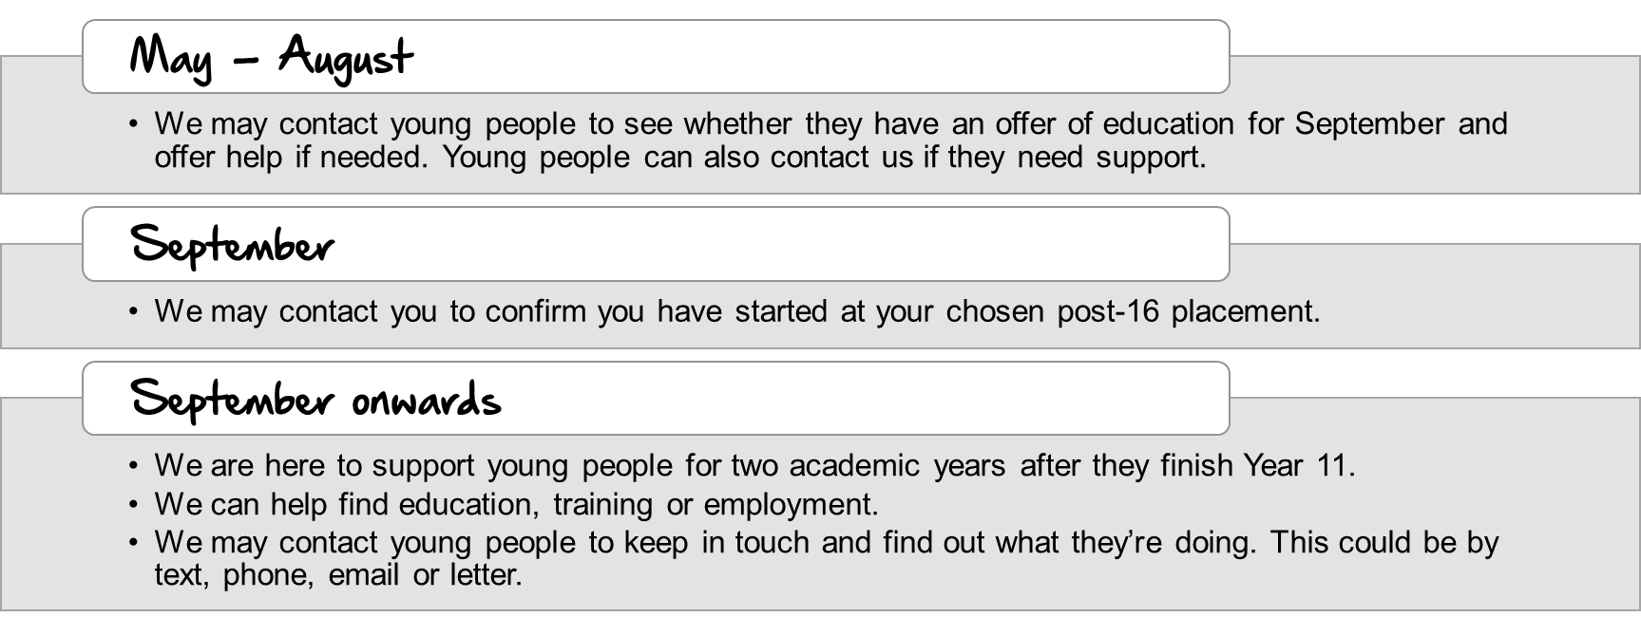
The Education People
MP/KD
Please speak to Liberty Hand for further information on:
Applications, Post-16 Options any other questions regarding educational requirements.
Please note the following from The Education People:

Slide 22
Kent Choices website is there to help

Slide 23
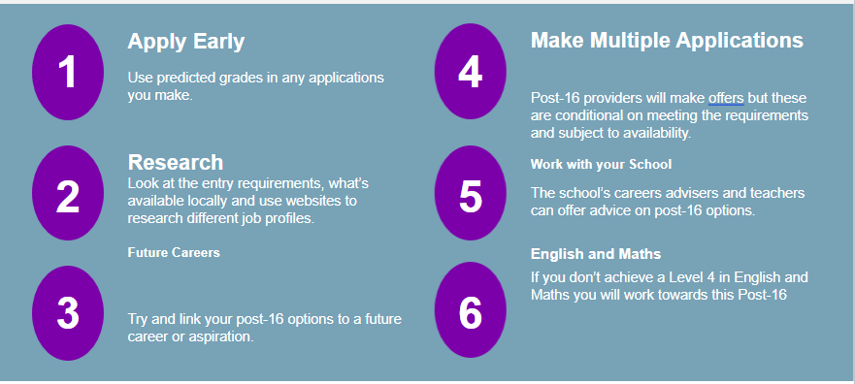
Choosing an option
MP/KD

Slide 24
Mr L Morris
Mathematics

Slide 25
GCSE external Maths exams
Edexcel Mathematics (1MA1) for summer 2024
PAPER 1 (Non-Calculator)
All papers are 1hr 30mins​
Each paper will assess any topic from the curriculum.
Each paper has 80 marks and is equally weighted.
PAPER 2 (Calculator)
PAPER 3 (Calculator)
Foundation: Grades 1 - 5 (4 = C/D)
Higher: Grades 4 - 9 (6 = B, 7 = A)

Slide 26
Type of of exam questions:
 |  | Weighting
AO1 | Use and apply standard techniques | 50 (F) 40 (H)
AO2 | Reason, interpret and communicate mathematically | 25 (F) 30 (H)
AO3 | Solve problems with mathematics and in other contexts | 25 (F) 30 (H)

Slide 27
Foundation question
Challenges:
Students did the subtraction and did not think of the context of the question

Slide 28
Foundation/Higher crossover question

Slide 29
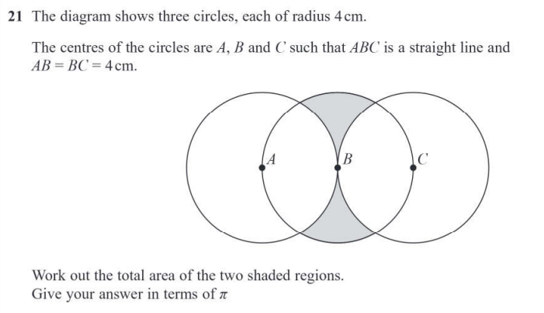
Higher question

Slide 30
Support for Maths
Pen, pencil, ruler, planner, geometry set and calculator every lesson
CGP Revision Guide. New Edexcel 9-1. Higher or Foundation.
Casio FX-83GTCW or Casio FX-991CW Calculator £6-£9 / £20-£22
https://sparxmaths.com/ to use independently. Homework will be a collection of Sparx and/or GCSE questions set by the class teacher each week. Due in on Monday every week.
October Mock (Non-calc) to check the correct tier before half term.
Maths masterclasses during tutor time, twice per half term.
Maths intervention during tutor time to focus on key knowledge needed to make good progress.

Slide 31
How to help your child
Encourage regular use of Sparxmaths on topics that are not secure.
Ensuring your child is completing their weekly homework on time.
Verbally test your child on recalling formulae from the GCSE formulae sheet (found on EDEXCEL website).
Check they have the correct equipment for each lesson.
Use CGP Revision Guides / Workbooks.
Encourage a little and often approach to revising.
Remind students that consistent self-testing of key facts AND lots of practice is the most effective way to study

Slide 32
Science
Key details:
AQA examining board
Separate Biology/Chemistry/Physics (3 GCSEs)
or Trilogy: Combined Science (2 GCSEs)
Pathway/level reviewed after mock examinations
Fully examination assessed – no coursework
Required practical work completed in class

Slide 33
Content
Chemistry
Atomic structure and the periodic table
Bonding, structure, and the properties of matter
Quantitative chemistry
Chemical changes
Energy changes
The rate and extent of chemical change
Organic chemistry
Chemical analysis
Chemistry of the atmosphere
Using resources
Biology
Cell biology
Organisation
Infection and response
Bioenergetics
Homeostasis and response
Inheritance, variation and evolution
Ecology
Physics
Energy
Electricity
Particle model of matter
Atomic structure
Forces
Waves
Magnetism and electromagnetism
Additional for Triple: Physics Space

Slide 34
Pathways
Combined Science: Trilogy
2 GCSEs
100% examination assessed
2x Biology, 2x Chemistry and 2x Physics papers
6 x 1 hour 15 minute examinations
Foundation and Higher Tier
Grades:
Foundation: Grades 1-5
Higher: Grades 4-9
Awarded as: 9/9, 9/8, 8/8, 8/7, 7/7, 7/6, 6/6 etc.

Slide 35
Pathways
Separate GCSEs: Biology/Chemistry/Physics
3 GCSEs
100% examination assessed
2x Biology, 2x Chemistry and 2x Physics papers
6 x 1 hour 45 minute examinations
Higher Tier only
Grades: 4-9 in each science
Awarded as: Biology 7, Chemistry 6, Physics 7

Slide 36
Required Practicals
‘Practical work is at the heart of science – that’s why we have placed it at the heart of each of our GCSE science specifications. By carrying out carefully considered practical work, students will enhance their investigative thinking, improve their mastery of techniques and consolidate their understanding of key scientific concepts.’
These are completed
in class for all pathways

Slide 37
Style of exam questions:
Multiple choice, structured, closed short answer and open response.
 |  | Weighting
AO1 | Demonstrate knowledge and understanding of: scientific ideas; scientific techniques and procedures | 40
AO2 | Apply knowledge and understanding of: scientific ideas; scientific enquiry, techniques and procedures | 40
AO3 | Analyse information and ideas to: interpret and evaluate; make judgements and draw conclusions; develop and improve experimental procedures | 20

Slide 38
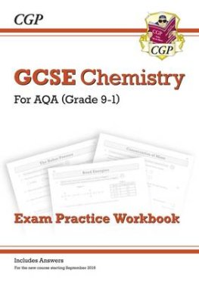
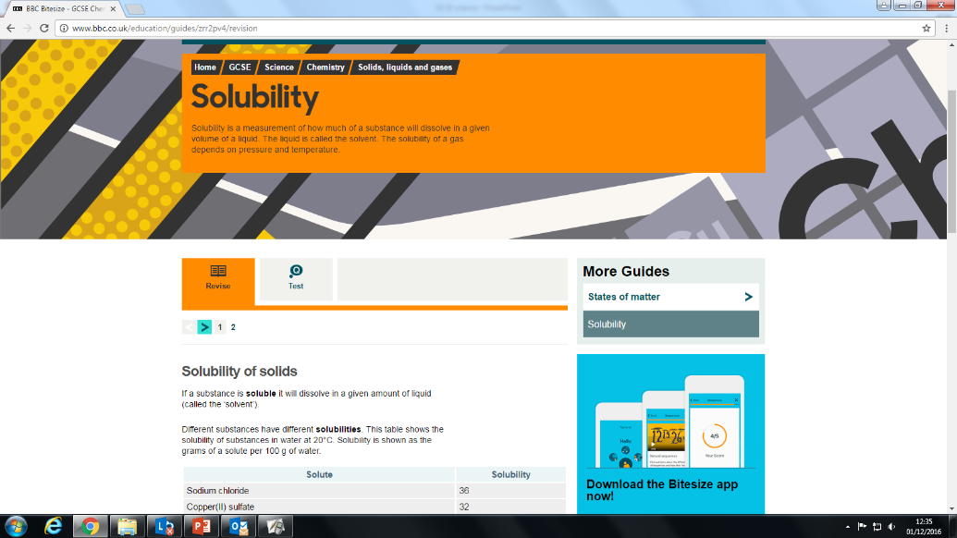
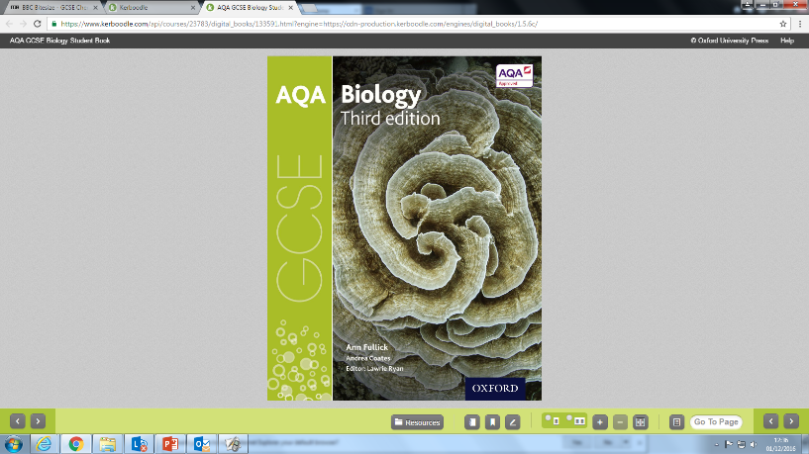
How to help your child:
CGP Bio/Chem/Phys or Trilogy Revision Guides/Workbooks
Seneca learning
AQA website has past papers to practice
BBC Bitesize
Supporting and prompting lots of practice on a regular basis
Intervention support running on Tuesdays after school

Slide 39
English
Ms S Fox

Slide 40
English Language and English Literature GCSEs
Two GCSEs - New specifications – both GCSEs in English ‘as important as each other’.
No Coursework or Controlled Assessments.
Spoken Language Component mark awarded. (Students deliver a speech/ presentation to peers and teacher)
100% exam.
More difficult in terms of content and expectations

Slide 41
English Language GCSE
Exam board: AQA
Two papers, each 1 hour 45 in length
Both exams are equally important
Dates: All dates are currently provisional and potentially subject to change
Paper 1 (fiction and creative writing) 23 May 2024
Paper 2 (non-fiction and informative/persuasive writing) 6 June 2024

Slide 42
Language: Where do we go next?
By December:
Students to have sound knowledge of question level requirements in every question
Students to know how to identify and comment on language techniques in writing, including word level analysis, and structural techniques in writing
Students to be able to produce different types of writing, creative fictional pieces and factual pieces
Students’ writing to be grammatically accurate, have correct spellings and contain different sentence types

Slide 43
Support for English Language 2023-2024
Pen, ruler, highlighters and whiteboard pens every lesson
Read outside of school, both fiction and non-fiction.
Know how to identify language techniques and structural techniques.
Revision guides and workbooks
Internal exams
Intervention groups
Practice past papers and familiarisation with exam http://www.aqa.org.uk/subjects/english/gcse/english-language-8700

Slide 44
English Literature GCSE
Exam board: AQA
Two papers, the first is 1 hour 45 and the second is 2 hours 15 in length
Both exams are equally important
Dates: All dates are provisional and potentially subject to change
Paper 1 (texts from the Literary Heritage) 13 May 2024
Paper 2 (modern texts) 20 May 2024

Slide 45
Literature: Where do we go next?
We are finishing the final topic this half term.
The majority of Year 11 is revision of the following:
Shakespeare: Macbeth
Nineteenth-Century Novel: The Sign of Four (Arthur Conan Doyle)
Modern Text: An Inspector Calls (J.B. Priestley)
Poetry Anthology: Power and Conflict poetry cluster from the AQA anthology
Unseen Poetry: Practise of unseen poetry

Slide 46
Support for English Literature 2023-2024
Pen, ruler, highlighters and whiteboard pens every lesson
Re-read the texts and know them inside out. Revision lessons will focus on important scenes – not the whole text.
Know key characters and key themes for each text.
Start to memorise quotes for each text.
Revision guides and workbooks later in the year
Internal exams
Intervention groups
Practice past papers and familiarisation with exam http://www.aqa.org.uk/subjects/english/gcse/english-literature-8702

Slide 47
Pastoral and Revision
Mr Pryse
Head of Year 11

Slide 48
Year 11 Tutor Team
Head of Year 11 - Mr Matt Pryse
Tutor Team
Maths – Leon Morris (HoD Maths)
English – Ms Williams (HoD English)
Science 1 – Ms Robinson (HoD Science)
Science 2 – Ms Walker (2ic Science)

Slide 49
Homework and Equipment
Students receive approximately 1 hour of homework per subject per week.
Before tests, students should also be independently revising.

Slide 50
Internal exams
Year 11 sit two internal exam series during this academic year
7th-17th November 2022 and 26th February – 8th March 2022
Throughout the year there are other internal mocks for subjects such as Art, PE, Drama and Music
Internal exam results day
‘Boosters & Briefings’ - before the exam, during the external series

Slide 51
External exams
Start in May and go into June.
Students will not have study leave so they have dedicated teacher support in class.
There are other external exams throughout the year that students must be present for eg English, Art, Music, PE, Drama, Food. These count towards their GCSE grade
It is not possible to change the date for any exam and 100% attendance is expected. This includes Art and Drama practical dates.

Slide 52
Mentoring
Later in the year, some students will be assigned a mentor if we feel they need additional support, however students will always have the opportunity to talk to a teacher about the following:
Discuss subjects
Homework/subject deadlines
Revision planning
Exams

Slide 53
Year 11 Timeline
7th-17th November: Mock Exams 1
6th December: First Reports Home
7th December Crown and MW parents evening – on site
13th December Olantigh and Stour parents evening – on site
26th-8th March February: Mock Exams 2
18th March: Second Reports Home
22nd April: Y11 Invite Only Parents evening for students of concern
9th May: First GCSEs commence

Slide 54
Parents’ Evenings
In person
Drop in Independent careers advice available from KCC on site.
What should I be asking?
Progress
My child's engagement
Strengths and weaknesses
How can I help at home?

Slide 55
Revision Materials/Books
A list of the specific revision guides you will need is available on the website.
Targeted revision materials/books
Be specific with general revision websites
Sample assessment materials
Past Papers

Slide 56
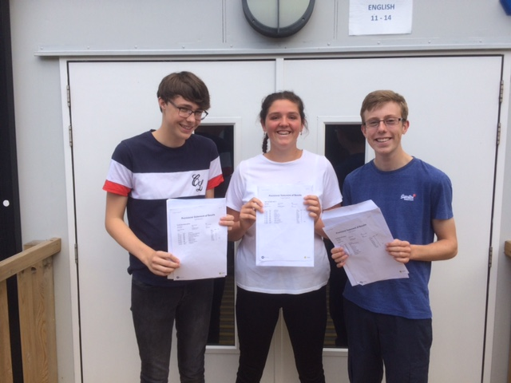
GCSE RESULTS DAY
Thursday 22nd August

Slide 57
For any questions, please feel free to talk to any member of staff after the meeting and we will be happy to help.

